Slide 1

Building a Book Recommendation System
By Alena Tskhondiya

Slide 2
Problem statement
Which book should I read next?
Goodreads.com is a social cataloging website that allows individuals to freely search its database of books, annotations, and reviews.
This problem is very relevant for Amazon or any other related company since it can potentially increase its profits as it gives recommendations of interest to their clients. Some of the key statistics about recommender systems are the following:
At Netflix, 2/3 of the movies watched are recommended.
At Google, news recommendations improved click-through rate (CTR) by 38%.
For Amazon, 35% of sales come from recommendations.

Slide 3
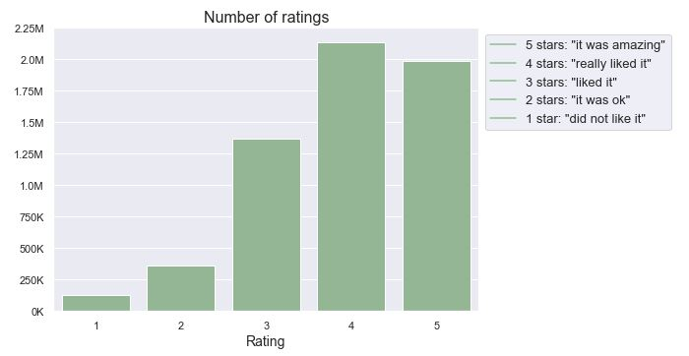
Exploratory Data Analysis
How are ratings distributed?
Do people tend to give higher or lower ratings?

Slide 4
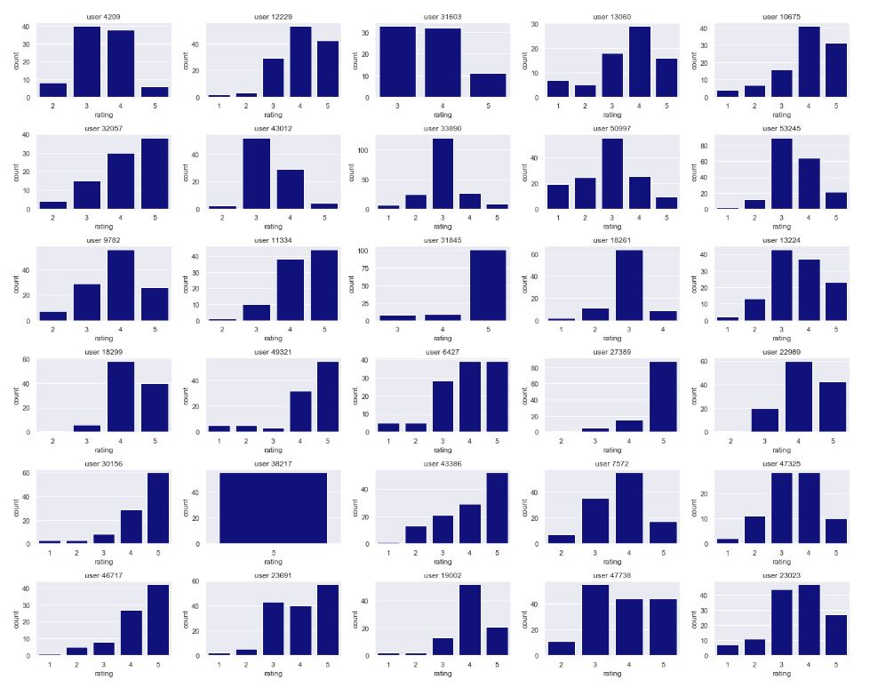
Exploratory Data Analysis
Do distributions of ratings among users vary significantly?

Slide 5
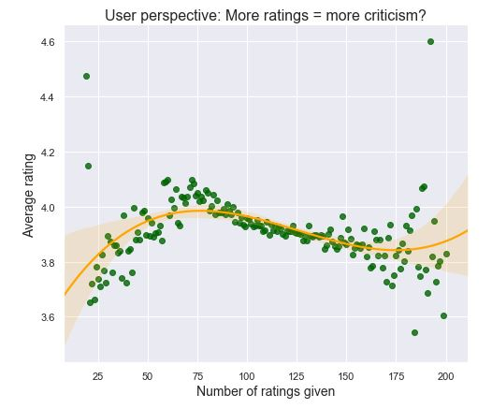
Exploratory Data Analysis
How does the AVERAGE rating given by a user evolves as the number of his/her number of given ratings increases, on average?
Do people tend to become more critic and give lower ratings?

Slide 6
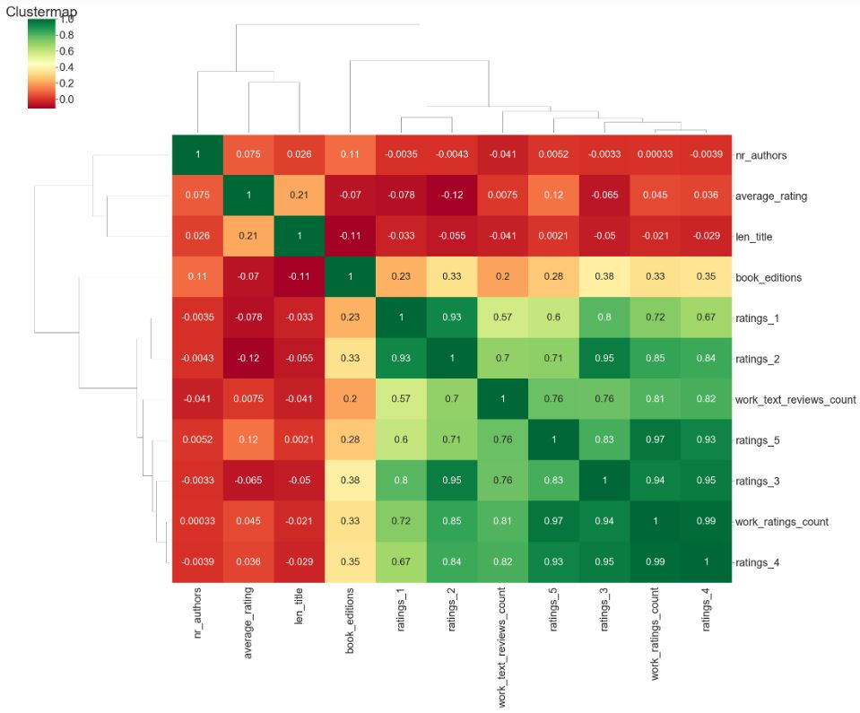
Exploratory Data Analysis
Correlations between some relevant variables

Slide 7
Recommendation Systems
What typically works:
Do appropriate data preprocessing and dimensionality reduction using matrix factorization.
Combine methods through ensembles.

Slide 8
Building the Recommendation System
Steps:
Build a matrix factorization algorithm using ALS (Alternating Least Squares) for implicit feedback.
Test & Choose an Explicit Rating Classifier.
Dimensionality reduction & Feature selection.
Hyperparameter Tuning & Probability calibration.
Build the recommendations using the chosen model.

Slide 9
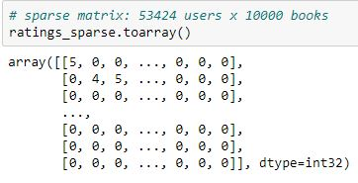
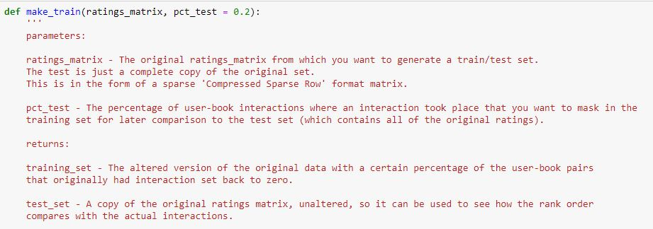
1) Build a matrix factorization algorithm using ALS for implicit feedback.
Create a sparse matrix with 53,424 rows (number of unique users) and 10,000 columns (number of unique books), which, when considering the almost 6 million ratings, gives us a sparsity value of 98.9%.
Define a function which takes the user-book matrix and "mask" a percentage of the original ratings where a user-book interaction has taken place.
The test set contains all the original ratings (but as a binary choice), while the training set replaces the specified percentage of them with zero in the original ratings matrix.
Create an ALS model
Results: 95.8% mean AUC score against the test set

Slide 10
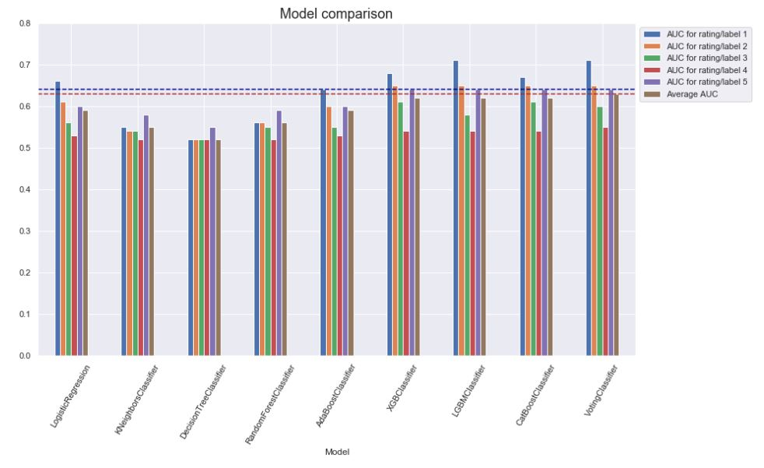
2) Test & Choose an Explicit Rating Classifier.
Features:
ALS
Number of ratings given by the user
Average rating of the book
Number of 5-star ratings; Number of 4-star ratings; Number of 3-star ratings; Number of 2-star ratings; Number of 1-star ratings
Number of book editions
Chosen Model: LGBMClassifier
Average AUC: 0.63

Slide 11
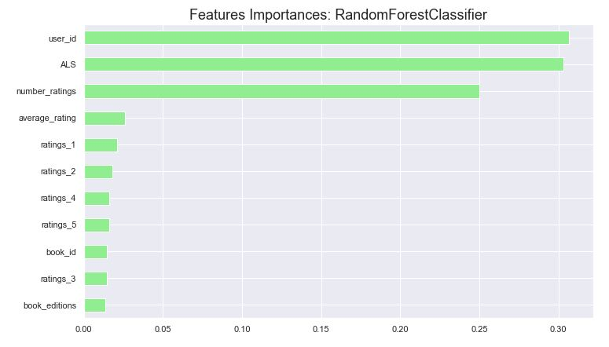
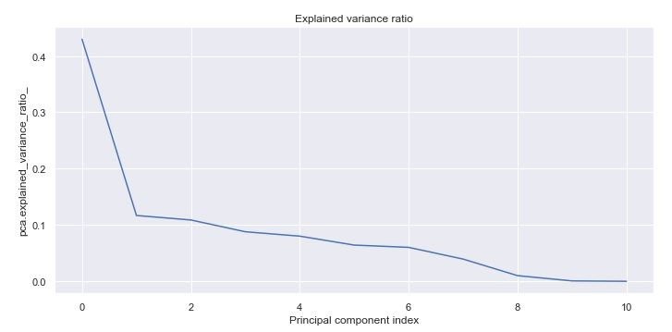
3) Dimensionality reduction & Feature selection.
Methods used:
Random Forest Classifier: feature importances
Recursive Feature Elimination (RFE): iterate over rankings
Principal Component Analysis (PCA): the “Elbow method”
Chosen Features:
user_id
ALS
Number of ratings (user)
book_id
Number of ratings 1
Number of ratings 4
Average rating (book)

Slide 12
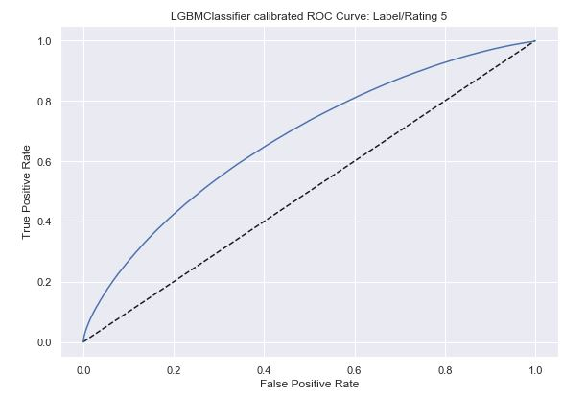
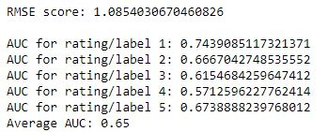
4) Hyperparameter Tuning & Probability calibration.
Tuning hyperparameters of the LGBMClassifier
New Average AUC: 0.65
New RMSE score: 1.64
The usage of all these parameters result in poor estimates of the individual class probabilities → This probability gives some kind of confidence on the prediction.
Using sklearn’s CalibratedClassifierCV, the results were further improved.
The ROC curve for the highest possible rating, 5, was especially important for the next step.

Slide 13
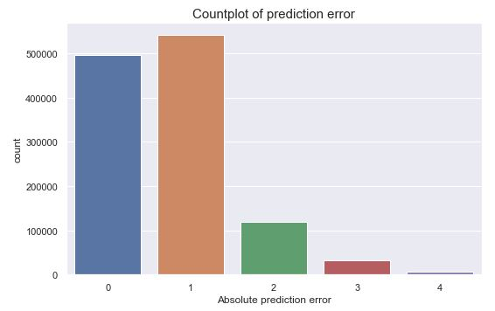
5) The Recommendation System
Prediction error: the model gave good prediction results, where most of the errors were either 0 or 1, in terms of difference from the actual rating (test set)
To actually give recommendations, I used the highest scoring probabilities of having a rating equal to 5.
To check the given recommendations (highest scoring probabilities of having a rating equal to 5), I compare them to the highest rating books of the user and take the difference on the rating as a measure of failed recommendation.

Slide 14
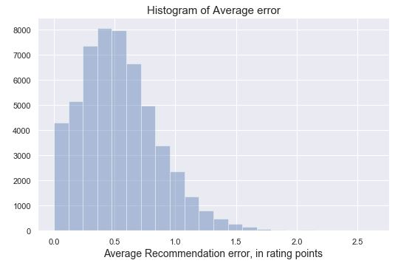
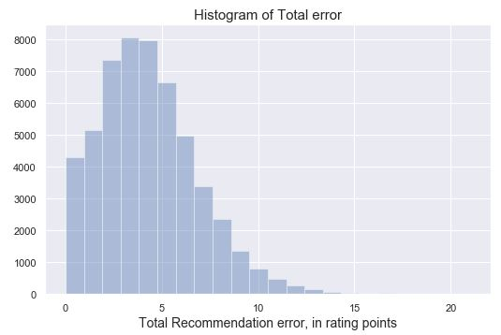
5) The Recommendation System
Considering all users and 8 as the number of recommendations to give, the average error of the recommendations was, in rating points, equal to about 0.50, that is, half a rating point.
The total error averages around 4 (again, considering 8 recommendations to each user).
When analyzing the distribution of either the total error or of the average error, we see that it exponentially decays when it arrives the mentioned mean values.

Slide 15
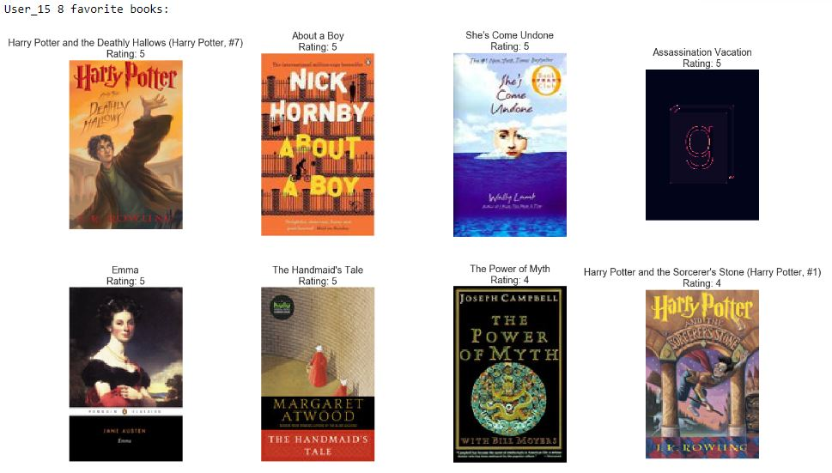
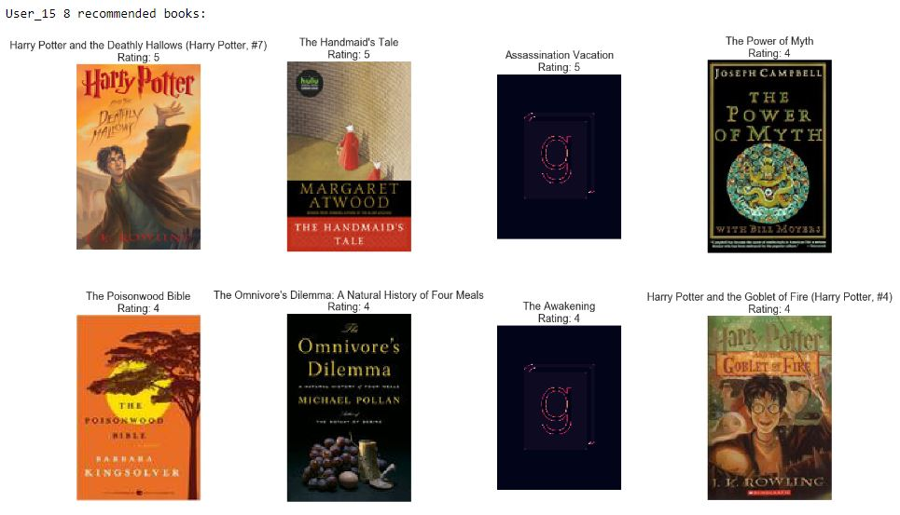
Individual example: User nº 15
Now considering the test set, these were the highest rated books by this user:
The recommendations, on the other hand, were:

Slide 16
Conclusion
The built recommendation system works as follows:
First, build a matrix factorization algorithm using ALS (Alternating Least Squares) in order to get implicit feedback. In other words, an algorithm that could predict if the user read a certain book or not, regardless of his opinion of the book. This could be seen as an attempt to study user behavior, in the sense that it tries to predict general/implicit preferences. The test score was pretty good, with a mean AUC of 0.96.
Using that implicit behavior as an extra feature, we then started to build the recommendation system by testing several algorithms and predict the user rating (explicit behavior). This was made after doing an initial feature selection, which was mainly based on the previous exploratory data analysis phase. Although the one with better results was a Voting Classifier ensemble using 3 of the models, I chose to go with the Light Gradient Boosting (LightGBM) algorithm, which got similar but much faster results.
Then, through principal component analysis (PCA), Recursive Feature Elimination (RFE) and also considering the feature importances obtained when testing the Random Forest Classifier, further feature selection was made, reducing the chosen features to 7.
After that, the chosen model was tuned on 4 major parameters. Then we went further to perform probability calibration using sklearn's CalibratedClassifierCV. This was important for the next step. The final model got an RMSE score of 1.08 and an average AUC of 0.66.
The recommendations were based using the highest scoring probabilities of having a rating equal to 5 - the highest score a book can have. After testing with other methods, this one got better results.
Against the test dataset it got an average error of 0.5, in terms of rating points. This means that the 8 recommended books were, on average, 0.5 rating points below the 8 highest rating books of the user, that is, on what would be a perfect score (error 0).

